Slide 1

Read Write Inc Phonics
Parent workshop

Slide 2
What is Read Write Inc?
Comprehensive programme
Moves from teaching single sounds to reading fluently

Slide 3
Speed sounds
20 minutes daily
Reviews previously learnt sounds
Teaches new sounds
Read them in real words and nonsense words
Practice spelling the new sound in words

Slide 4
Reading Lesson
Follows speed sound lesson
Review speed sounds
Introduce story green words
Read red words
Teacher reading
Partner practice
Assessment

Slide 5
Story books
How best to use them
Notes:
https://www.oxfordowl.co.uk/api/interactives/34280.html

Slide 6
Progression
Sound Blending
Ditty
Red
Green
Purple
Pink
Orange
Yellow
Blue
Grey

Slide 7
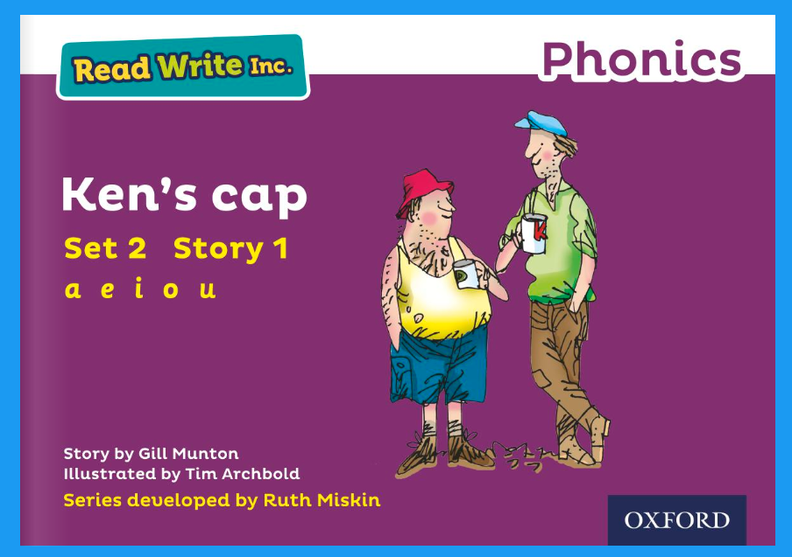

Slide 8
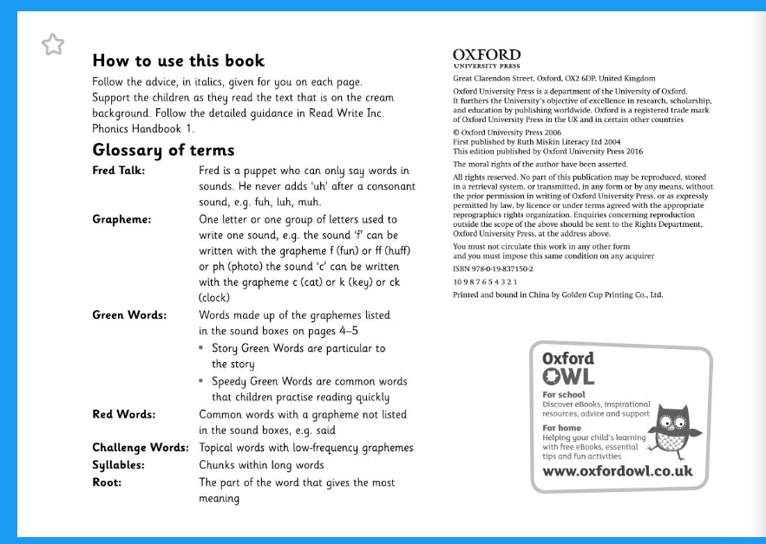

Slide 9
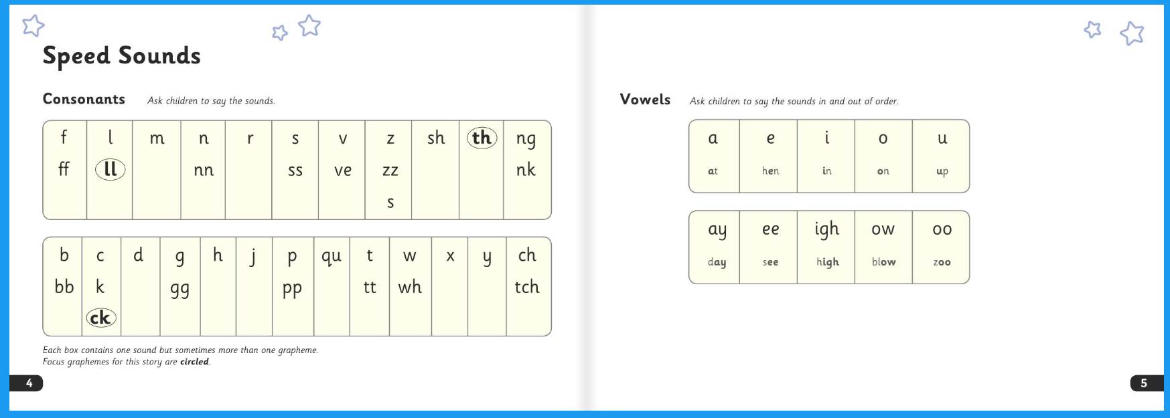

Slide 10
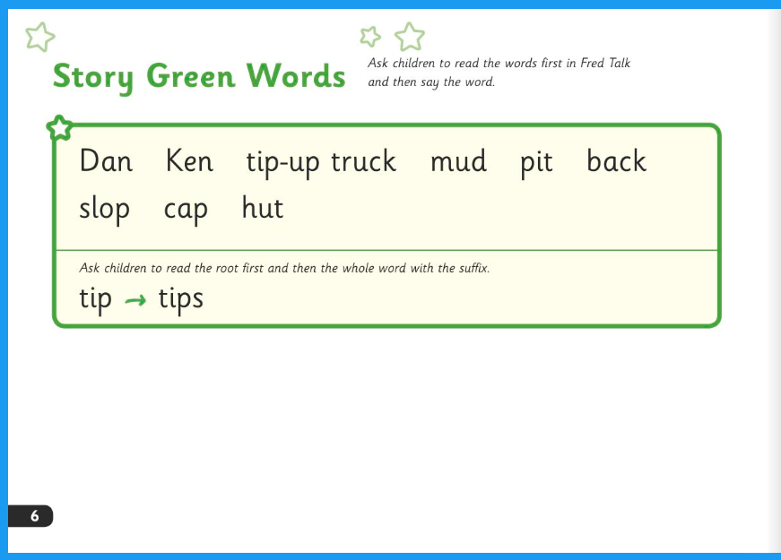

Slide 11
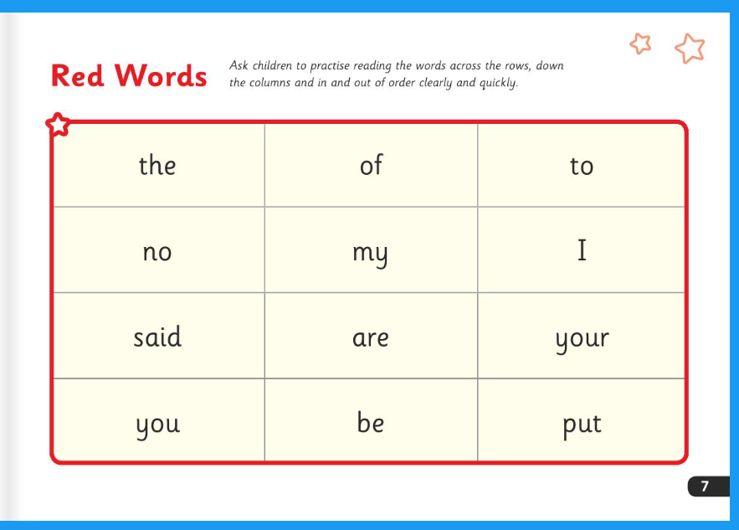

Slide 12
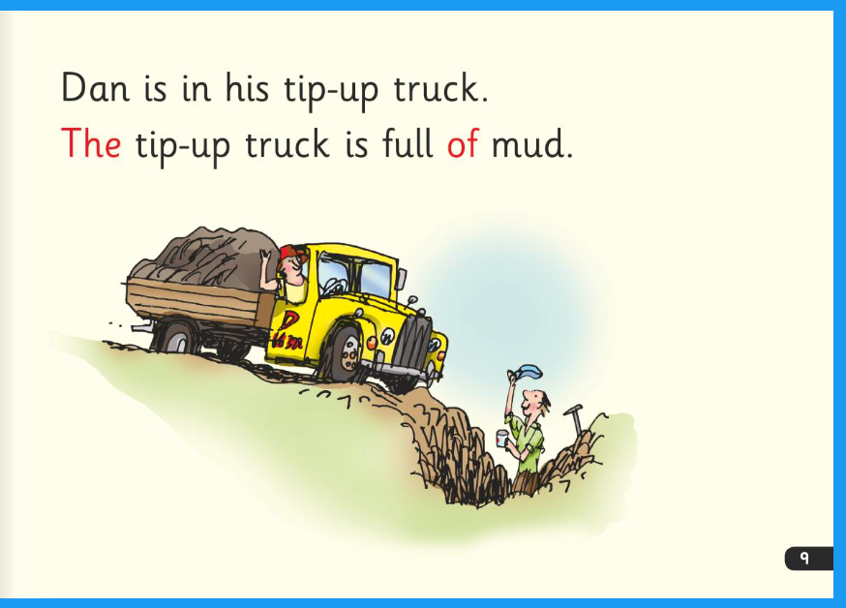

Slide 13
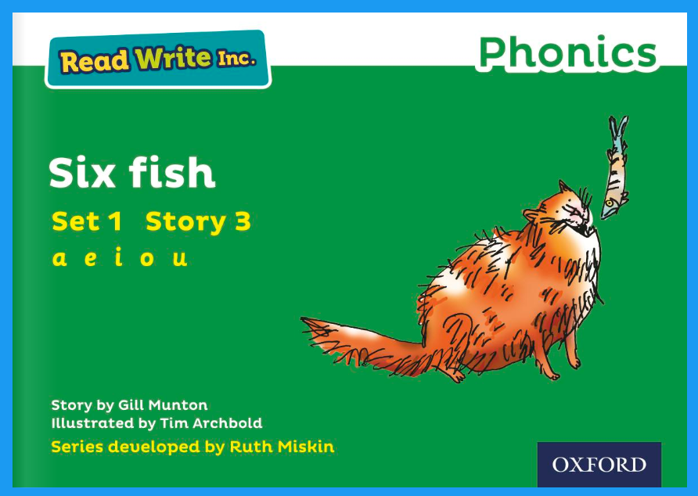
Reading Books
The book they have just read in class with their focus sounds
A book they have previously read, they should be familiar with all the sounds

Slide 14
Oxford Owl

Slide 15
How we use it and expectations
Each week we will allocate their new book and corresponding quiz on Oxford Owl
As long as you are reading the books we send home you do not have to use the website
Website will contain books they have previously been allocated and quizzes for additional practice

Slide 16
Reading to your child

Slide 17
Reading for pleasure
Don’t stop reading to your child when they can read
Children learn so much from being read to:
  Intonation
  Prediction skills
  Enjoyment
  Opportunities to ask questions
  Access to texts higher than their reading ability
  Vocabulary

