Slide 1

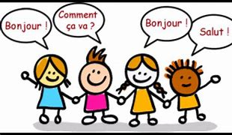
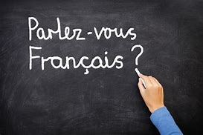
French Year 3 Term 1: Core 1
Subject Specific Vocabulary
Lesson 1 Hello | Bonjour! Hello! Au revoir! Goodbye! Salut! Hi! Bonsoir! Good evening! À bientôt! See you soon! Monsieur sir Madame madam
Lesson 2 How are you? | très bien very well bien well comme ci, comme ça so-so mal not well Merci thanks et toi? and you?
Lesson 3 What is your name? | French names eg Aurélie Élodie Camille Lucas Gabriel Raphaël
Lesson 4 How old are you? | un one deux two trois three quatre four cinq five six six sept seven huit eight neuf nine dix ten
Subject Specific Vocabulary
Lesson 5 My family | ma mère my mother mon père my father ma sœur my sister mon frère my brother ma grand-mère my grandmother mon grand-père my grandfather
Lesson 6 My fantastic family | tout le monde everyone voici here is inventer des histoires to make up stories j’aime I like
Questions and Answers
Ça va? How are you?
Ça va… I’m…
Comment tu t'appelles? What is your name?
Je m'appelle... My name is...
Quel âge as-tu? How old are you?
J'ai … ans. I’m … years old.
C'est qui? Who is it?
Voici... Here is...
Sticky Knowledge
• Recognise some basic French greetings. • Recognise the numbers 1-10. • Respond to some simple classroom instructions. • Respond to some simple questions when prompted with visual cues. • Recognise basic family vocabulary.

Slide 2
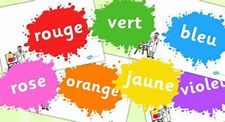
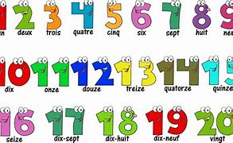
French Year 3 Term 2: Core 2
Subject Specific Vocabulary
Lesson 1 Hello. Mrs Monday | lundi Monday mardi Tuesday mercredi Wednesday jeudi Thursday vendredi Friday samedi Saturday dimanche Sunday danser to dance
Lesson 2 Colours | rouge red vert green blanc white bleu blue jaune yellow noir black rose pink violet purple orange orange
Lesson 3 Counting to 20 | onze eleven douze twelve treize thirteen quatorze fourteen quinze fifteen seize sixteen dix-sept seventeen dix-huit eighteen dix-neuf nineteen vingt twenty
Lesson 4 Countries | la Pologne Poland l'Angleterre (f) England l'Écosse (f) Scotland l'Irlande (f) Ireland le pays de Galles Wales l'Inde (f) India le Pakistan Pakistan la Chine China la France France
Subject Specific Vocabulary
Lesson 5 I like … | j'aime... I like… je n'aime pas… I don’t like… oui yes non no le chocolat the chocolate la musique the music les biscuits (m) the biscuits le tennis tennis
Lesson 6 Nicolas the monster | un monstre a monster un hamster a hamster un robot a robot un train a train un vampire a vampire je mange I eat malade ill
Sticky Knowledge
• Recognise the days of the week when spoken in sequence. • Understand most of the colours. • Understand numbers up to 20. • Respond to questions about likes and dislikes with a single word. • Recognise negative responses to a question when given a visual prompt.
Questions and Answers
On est quel jour? What day is it?
On est… It is…
C'est de quelle couleur? What colour is it?
C'est… It’s…
Il y a combien de biscuits? How many biscuits are there?
Il y a…biscuits. There are…biscuits.
C'est quel pays? What country is it?
C'est... It’s...
Tu aimes…? Do you like…?
Oui, j'aime… Yes, I like...
Non, je n'aime pas… No, I don’t like…

Slide 3
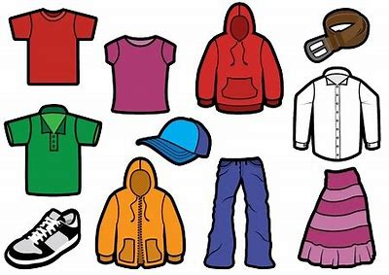
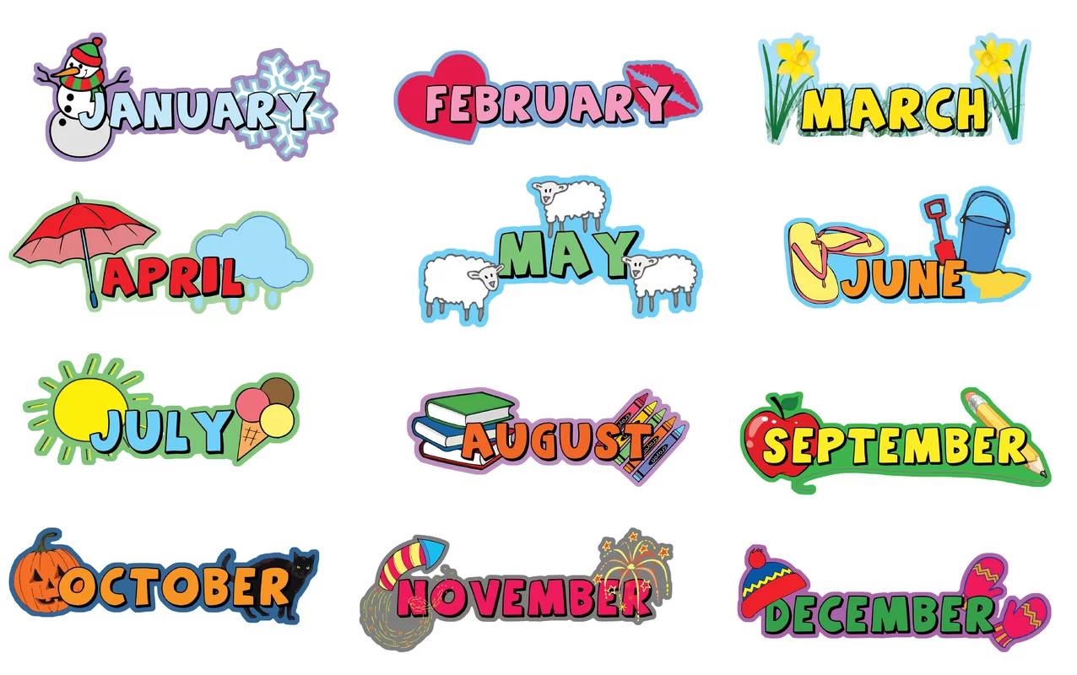
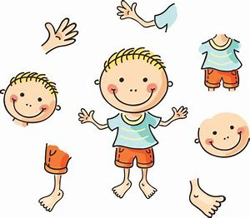
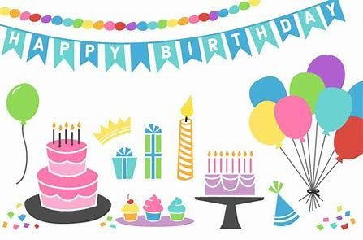
French Year 3 Term 3: Core 3
Subject Specific Vocabulary
Lesson 1 Heads, shoulders, knees and toes | la tête the head les épaules (f) the shoulders les genoux (m) the knees les pieds (m) the feet le nez the nose les yeux (m) the eyes les oreilles (f) the ears la bouche the mouth
Lesson 2 Parts of the body | le bras the arm la jambe the leg la tête the head le pied the foot le ventre the stomach le dos the back le genou the knee l'épaule (f) the shoulder la main the hand le doigt the finger
Lesson 3 Counting to 31 | vingt-et-un twenty-one vingt-deux twenty-two vingt-trois twenty-three vingt-quatre twenty-four vingt-cinq twenty-five vingt-six twenty-six vingt-sept twenty-seven vingt-huit twenty-eight vingt-neuf twenty-nine trente thirty trente-et-un thirty-one
Lesson 4 Clothes | une robe a dress un pantalon trousers un pull a jumper un tee-shirt a T-shirt une chemise a shirt une jupe a skirt
Subject Specific Vocabulary
Lesson 5 Months | janvier January février February mars March avril April mai May juin June juillet July août August septembre September octobre October novembre November décembre December
Lesson 6 Geneviève’s birthday | un cadeau a present un crocodile a crocodile un tee-shirt a T-shirt un robot a robot un hippopotame a hippopotamus un livre a book du chocolat some chocolate laid ugly ronfler to snore
Questions and Answers
Qu'est-ce que c'est? What is it?
C'est… / Ce sont… It’s… / They’re…
Comment est mon monstre? What’s my monster like?
Il a… He has…
Il y a combien de chocolats? How many chocolates are there?
Il y a … chocolats. There are … chocolates.
Qu'est-ce que c'est? What is it?
C'est... It’s...
C’est quand, ton anniversaire? When is your birthday?
Mon anniversaire est en... My birthday is in...
Sticky Knowledge
• Sing along and do the actions to a French song, with a visual aid. • Recognise most of the French body parts when they’re spoken. • Read the numbers 11-20 with some assistance. • Accurately say the name of the month of their birthday when given a visual prompt. • Understand the difference between singular and plural.

Slide 4
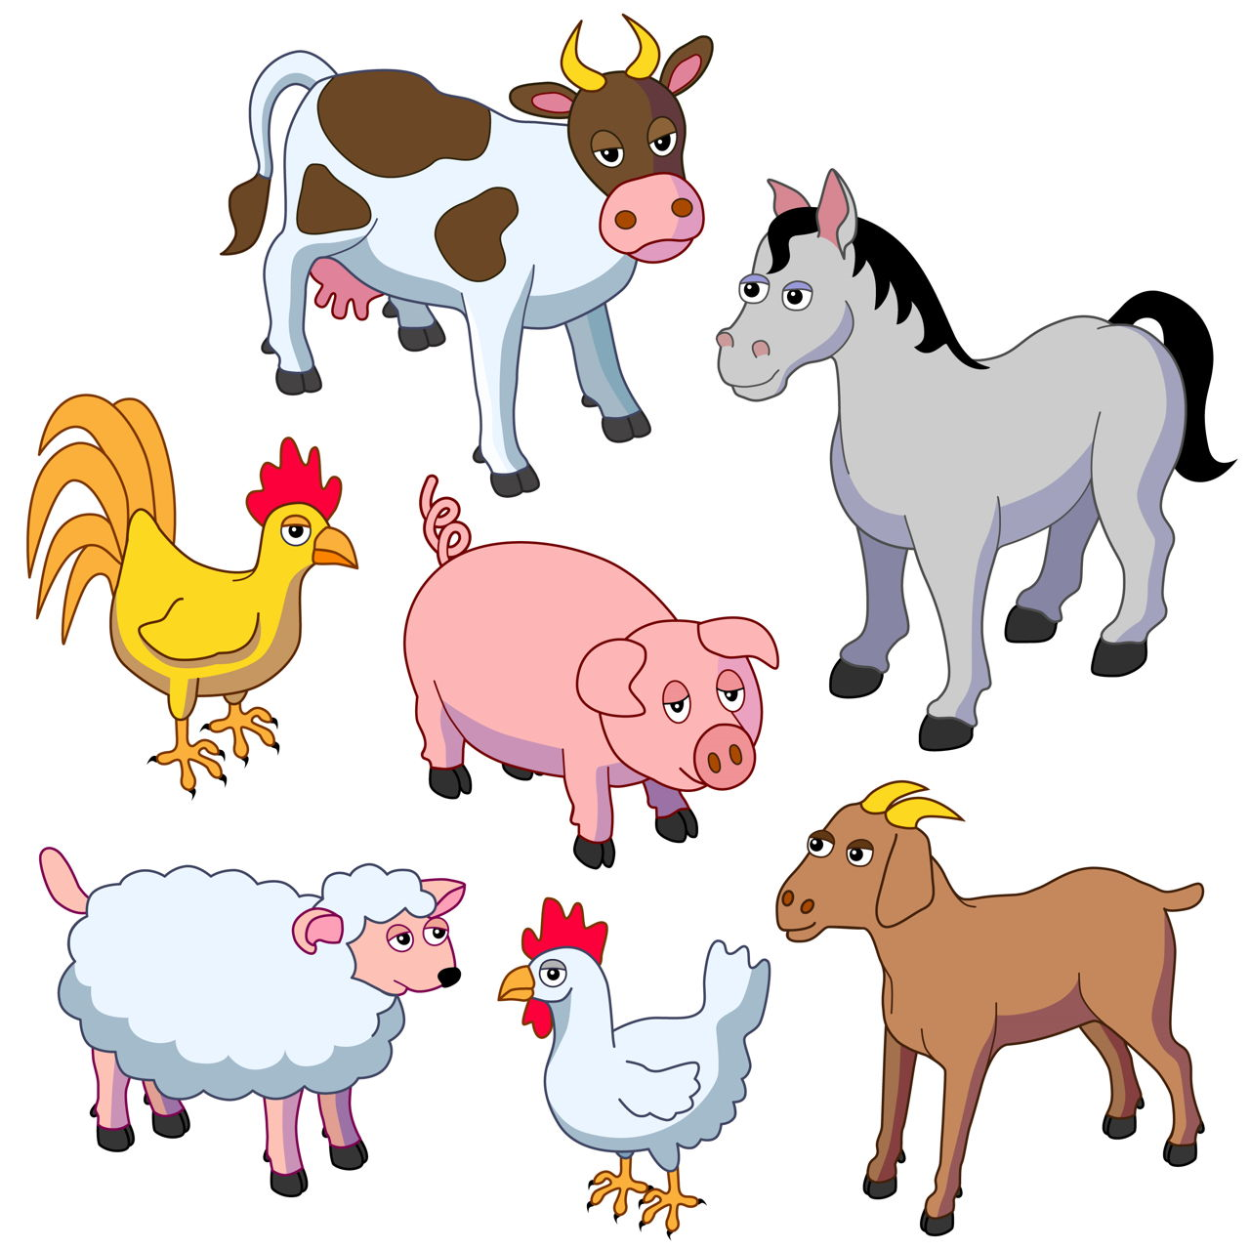
French Year 3 Term 4: Animals
Subject Specific Vocabulary
Animal Names | un mouton (a sheep) une poule (a hen) un coq (a cockerel) un cochon (a pig) une vache (a cow) un canard (a duck) un cheval (a horse) un chien (a dog) un chat (a cat) un hamster (a hamster) un poisson (a fish) un lapin (a rabbit) un chevel (a horse) un serpent (a snake) une souris (a mouse) un cochon d'Inde (a guinea pig) un oiseau (a bird)
Adjectives inc colours | marron (brown) gris (grey) blanc (white) noir (black) méchant (naughty) grand (big) petit (small) gentil (friendly) mignon (cute) petit (small) timide (shy) anxieux (anxious)
Positional Language | devant (in front of) derrière (behind) dans (in) sur (on) sous (under) en face de (opposite) à côté de (next to) la table (the table) la boîte (the box)
Places | un arbre (a tree) une maison (a house) un appartement (a flat) une écurie (a stable) un champ (a field) un lac (a lake) un terrier (a burrow) une niche (a kennel)
Verbs | regarder (to look) écouter (to listen)
Family Names | ma mère (my mother)
Sticky Knowledge
Be able to respond to questions when given a spoken model to copy.
Repeat a simple phrase to say that they don’t understand something.
Hear a simple sentence and then repeat it orally.
Copy down a short, simple sentence.
Read a short rhyme with help
Recognise some basic French adjectives such as colours.
Cultural Knowledge
Identifies France on a map Names other French speaking countries Recognises flags of French speaking countries around the world
Questions and Answers
Qu'est-ce que c'est? What is it?
C’est… It’s…
Tu as des animaux domestiques? Do you have any pets?
Non, je n'ai pas d'animaux domestiques. No, I don't have any pets.
Oui, j'ai… Yes, I have…
Ton chien est comment? What’s your dog like?
Il est... It is...
Où est le chat? Where is the cat?
Le chat est... The cat is...
Où est l'éléphant? Where is the elephant?
Il est dans... It’s in...

Slide 5
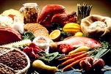
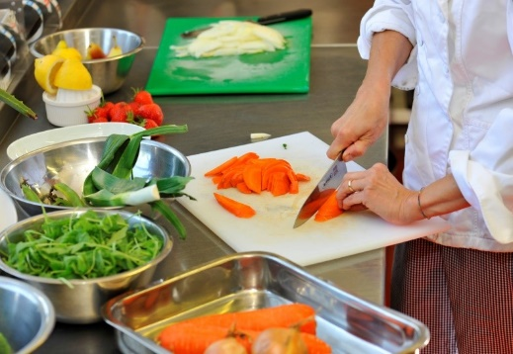
French Year 3 Term 5: Food
Subject Specific Vocabulary
Lesson 1 | une glace (an ice cream) un gâteau (a cake) des chips (f) (some crisps) un chou (a cabbage) des petits pois (m) (some peas) un poisson (a fish)
Lesson 2 | les pommes (f) the apples les fraises (f) the strawberries les tomates (f) the tomatoes les carottes (f) the carrots les bananes (f) the bananas les poires (f) the pears les pommes de terre (f) the potatoes les cerises (f) the cherries les raisins (m) the grapes
Lesson 3 | un sandwich a sandwich des frites (f) some chips du chocolat some chocolate de la pizza some pizza des spaghettis (m) some spaghetti du fromage some cheese du poulet some chicken du riz some rice
Lesson 4 | un couteau a knife une fourchette a fork une cuillère à soupe a tablespoon une cuillère à cafe a teaspoon un bol a bowl une poêle a frying pan un verre a glass une tasse a cup
Subject Specific Vocabulary
Lesson 5 | les œufs (m) the eggs le lait the milk le sucre the sugar le pain the bread le beurre the butter la cannelle en poudre the ground cinnamon
Lesson 6 | Mélanger to mix tremper to soak mettre to put faire cuire to cook saupoudrer to dust
Questions and Answers
Qu'est-ce que c'est? What is it?
C'est… / Ce sont… It’s… / They’re…
Tu aimes…? Do you like…?
Oui, j’aime… / Non, je n’aime pas… Yes, I like… / No, I don’t like…
Qu'est-ce que tu manges? What are you eating?
Je mange... I'm eating...
Qu'est-ce que c'est? What is it?
C'est... It’s...
Qu'est-ce que vous désirez? What would you like?
Je voudrais…, s'il vous plaît. I would like…, please.
Sticky Knowledge
Give a spoken response to a simple written question using a single word answer. Pronounce some common letter strings correctly. Give an opinion in French with a visual prompt. Repeat a couple of sentences, including talking about what they would like, using the first person. Copy the main vocabulary with some mistakes.

Slide 6


French Year 3 Term 6: School
Subject Specific Vocabulary
Lesson 1 How do you go to school? | à pied on foot en bus by bus en voiture by car en train by train à vélo by bicycle en avion by plane en bateau by boat
Lesson 2 Rooms | la salle de classe the classroom la cour the playground la grande salle the hall les toilettes (f) the toilets la cuisine the kitchen le parking the car park la bibliothèque the library le terrain de sport the sports ground la salle d'informatique the computer room
Lesson 3 In your pencil case | un crayon a pencil une gomme a rubber une règle a ruler un stylo a pen une calculatrice a calculator un feutre a felt-tip pen un bâton de colle a glue stick un crayon de couleur a coloured pencil un taille-crayons a pencil sharpener des ciseaux (m) a pair of scissors
Lesson 4 What time is it? | midi midday minuit midnight du matin in the morning du soir in the evening de l'après-midi in the afternoon de la nuit in the night et demie half past
Subject Specific Vocabulary
Lesson 5 Subjects | les mathématiques (f) maths l'anglais (m) English le français (m) French les sciences (f) science le sport PE le dessin art l'informatique (f) ICT la musique music l'espagnol (m) Spanish
Lesson 6 The magic bag | l'école (f) school un sac a bag une calculatrice a calculator une flûte a flute une souris a mouse un éléphant an elephant
Questions and Answers
Comment vas-tu à l'école? How do you go to school?
Je vais à l’école en/à… I go to school on/by…
Qu'est-ce que c'est? What is it?
Voici… It’s…
Qu'est-ce qu'il y a dans ta trousse? What is there in your pencil case?
Il y a... There’s…
Quelle heure est-il? What time is it?
Il est... It’s...
Quelle est ta matière préférée? What's your favourite subject?
Ma matière préférée, c’est... My favourite subject is...
Sticky Knowledge
Be able to respond to questions using one-word answers or gestures. Use numbers in a sentence to tell the time with some support. Repeat basic questions. Pronounce vocabulary, including articles, correctly with some support and visual aid. Copy down singular nouns with their article. Pronounce some French sounds correctly. Follow a story as it is read, with visual prompts. Identify a sound in a song with some help. Understand that plural nouns have a different article to singular nouns.

